Slide 1
Ethereum
Bernard Parenteau
bparente@fit.edu
February 2019

Slide 2
Ethereum
Ethereum is a programmable Blockchain environment.
It is similar to the Bitcoin blockchain in a number of ways:
It uses a distributed blockchain to which anyone can connect
There are miners that create new blocks from waiting transactions and receive a reward for doing so
There are nodes that store the state and that can validate the blocks
Transactions can be used to send tokens from one user to another

Slide 3
Ethereum
It is also dissimilar from the Bitcoin blockchain in many ways, including:
It has its own blockchain; it does not use the Bitcoin blockchain
The mining algorithm is purposely different to avoid the concentration of mining power
Its accounts can be user accounts or contracts
The contracts are programmable; they can be created by any user
That last point is perhaps the most important:
Ethereum is designed to enable Smart Contracts

Slide 4
Ether
ETH (“ether”) is Ethereum’s cryptocurrency. It’s meant to pay for work on the Ethereum platform rather than to be a general purpose currency.
However it trades like any other virtual currency.
From January 2017 to January 2018 it went from $10 to over $1000
From January to December 2018 it went from over $1000 to under $90

Slide 5
Ethereum
Ethereum was first described in a paper in late 2013 by Vitalek Buterin
In late 2013/early 2014, Ethereum founders Vitalik Buterin and others began work on a next-generation blockchain with the goal of implementing a general, fully trustless smart contract platform. It was part of Swiss Ethereum Gmbh and later The Ethereum Foundation, a Swiss non-profit.
It was funded by a pre-sale of Ether in summer 2014. The price was originally 2000 ETH per BTC.
In July 2015 the first client was released.
Current version of whitepaper / documentation
1. https://github.com/ethereum/wiki/wiki/White-Paper

Slide 6
Ethereum
As Bitcoin gradually became more popular in its first few years of existence, developers began to use the network and/or forks of the network for various purposes. Many were other cryptocurrencies with additional features.
In Buterin’s paper, he proposed that a single blockchain with the capability to run any number of user-defined programs, each keeping their own state transition ledgers, could vastly improve upon and effectively supercede these efforts to work within and/or modify Bitcoin’s blockchain.
Ethereum does this by providing an abstract foundation layer: a blockchain with a built-in programming language, allowing anyone to write smart contracts and decentralized applications where they can create their own arbitrary rules for ownership, transaction formats and state transition functions.¹

Slide 7
Ethereum Accounts
Ethereum has user accounts similar to Bitcoin, and also has accounts that are user-defined contracts.
So Ethereum accounts are either:
User accounts (aka Externally Owned Accounts), which are controlled by private keys
Contract Accounts, which are controlled by their contract code and can only be “activated” by a user account
Each contract has its own context (e.g. its own data storage), that can be used to keep track of its own balances by address, similar to Bitcoin’s UTXO, or any other purpose.
Whereas the Bitcoin blockchain is a list of transactions, the Ethereum blockchain tracks the state of every account, and all state transitions on the Ethereum blockchain are transfers of value and information between accounts.

Slide 8
Transactions
Users can send a message to an account, like transfer of ETH or BTC.
Or they can send a message to a contract initiating an action.
This message may or may not contain units of account.
Contract accounts only perform an operation when instructed to do so by a user account, then cannot autonomously initiate actions.
They also cannot do things like random number generation.
This is because Ethereum requires all nodes to be able to agree on the outcome of computation, which requires a guarantee of strictly deterministic execution.

Slide 9
Ethereum Languages
Contracts can be written in several languages which compile to ethereum code
Solidity is Ethereum’s original contract definition programming language, though there are also compilers for other languages.
The vast majority of Ethereum Smart Contracts are written in Solidity.
Solidity is somewhat similar to javascript.
A new python-like language, Vyper, has recently been introduced for Ethereum smart-contract development
Most ICOs have been released on the Ethereum blockchain and funded by ETH.

Slide 10
Ethereum
So Ethereum is a programmable blockchain.
Rather than give users a set of pre-defined white-listed operations (e.g. bitcoin transactions), Ethereum allows users to create their own operations of any complexity they wish.
In this way, it serves as a platform for many different types of decentralized blockchain applications, including but not limited to cryptocurrencies.
Ethereum in the narrow sense refers to a suite of protocols that define a platform for decentralized applications.
At the heart of it is the Ethereum Virtual Machine (“EVM”), which can execute code of arbitrary algorithmic complexity.

Slide 11
EVM: World Computer
Like any blockchain, Ethereum also includes a peer-to-peer network protocol.
The Ethereum blockchain database is maintained and updated by many nodes connected to the network.
Each and every node of the main network runs the EVM and executes the same instructions. (at least for now)
For this reason, Ethereum is sometimes described as a “world computer”.

Slide 12
EVM
This massive parallelization of computing across the entire Ethereum network is not done to make computation more efficient.
In fact, this process makes computation on Ethereum far slower and more expensive than on a traditional “computer”.
Rather, every Ethereum node runs the EVM in order to maintain consensus across the blockchain.
Decentralized consensus gives Ethereum extreme levels of fault tolerance, ensures effectively zero downtime, and makes data stored on the blockchain forever unchangeable and censorship-resistant.

Slide 13
Ethereum Network
Private networks can also use the EVM.
An Ethereum network is a private network if the nodes are not connected to the main network nodes.
In this context private only means reserved or isolated, rather than protected or secure.
Connections between nodes are valid only if peers have identical protocol version and network ID.
So a network could also effectively be private by setting either of these to a non default value, for example using a unique network ID. (network ID 1 is the main network)

Slide 14
Ethereum Network
So the point of Ethereum isn’t to be fast or cheap; the point is to be trustworthy.
Any program that runs on Ethereum is guaranteed to run the same way everywhere, on every node.
Data stored on Ethereum is available everywhere, and it is permanent.
Ethereum is designed to be a place to run programs and store data that are ideally relatively simple, but for which trust is paramount.

Slide 15
Ethereum Network
And there are many situations where we do not need fast or powerful computers, just trustworthy ones.
There are already many applications on Ethereum that take advantage of this.
Devices like locks or cars that can respond to payments of cryptocurrency, or make payments themselves.
Other IoT transactions.
Voting and governance systems that are automatically enforced.
Prediction markets where people can bet on future events.
An immutable transaction record for accounting systems.
Platforms for musicians to sell their music, without anyone else getting a cut.
Any other tokenized assets.
More are constantly added.

Slide 16
Miners
Like in Bitcoin, users must pay small transaction fees to the network. This protects the Ethereum blockchain from frivolous or malicious computational tasks, like DDoS attacks or infinite loops.
The sender of a transaction must pay for each step of the “program” they activated, including computation and memory storage.
These fees are paid in amounts of Ethereum’s native value-token, ether.
These transaction fees are collected by the nodes that validate the network. These “miners” are nodes in the Ethereum network that receive, propagate, verify, and execute transactions.
The miners then group the transactions – which include many updates to the “state” of accounts in the Ethereum blockchain – into what are called “blocks”, and miners then compete with one another for their block to be the next one to be added to the blockchain. Miners are rewarded with ether for each successful block they mine.

Slide 17
Ethereum Hashing
Ethereum uses the Eth-hash mining algorithm, which purposely uses substantial memory in addition to computing power, so as to lend itself to general purpose computers rather than specialized ASICs
ASICs are Application Specific Integrated Circuits: chips designed to do a specific computation very efficiently.
Including memory-intensive read operations in the mining algorithm makes it more difficult to develop efficient ASICs.
ASICs have been designed for Bitcoin and subsequently the Bitcoin mining market is dominated by large mining operations with many relatively expensive ASIC machines
Ether’s ASIC-hard mining algorithm was designed so that general purpose CPUs or GPUs could be used relatively effectively and so there is likely to be a greater number of competitive miners, hence lesser concentration of mining power.

Slide 18
Ethereum Hashing Developments
Though Eth-Hash was designed to be ASIC-hard, it hasn’t proved to be ASIC resistant long-term as ASICs for Ethereum mining have been developed and are in use.
However the advantage that Eth-mining ASICs have over GPUs is much less that ASIC advantages for other cryptocurrency mining
It’s estimated to be 2 to 3 times that of GPUs, yet the cost is 8 to 10 times as much
In any case, in response to ASICs, in 2018 Ethereum devs proposed an extension to the Eth-Hash algorithm; a Prog-PoW mining algorithm (programmatic proof-of-work).
As of early 2019 the Prog-PoW update remains under consideration, though there is a testnet live

Slide 19
Prog-PoW
Prog-PoW is tuned for GPU mining (nVidia and AMD were consulted) and designed to minimize any advantages a single-purpose ASIC might have.
Some of the GPU tuning modifications include
A larger “mix state” used in the hashing which should provide GPUs with an advantage given their larger number of registers, which are faster than RAM
The addition of a random computing sequence to the main loop which should make it impossible to create an ASIC with a fixed-function pipeline that could have increased efficiency.
A number of other small tweaks meant to favor GPU cache design and DRAM size

Slide 20
Ethash
As we’ve seen, any computational problem that requires orders of magnitude more resources to solve algorithmically than it takes to verify the solution is a good candidate for proof of work.
Ethash is (still) the PoW algorithm for Ethereum. It is a modified version of the Dagger-Hashimoto algorithm.
See https://github.com/ethereum/wiki/blob/master/Dagger-Hashimoto.md for the original version.
The general route that the algorithm takes is as follows:
A seed can be computed for each block by scanning through the block headers up until that point.
From the seed, a 16 MB pseudorandom cache value can be computed.

Slide 21
Ethash
From the cache, a 1 GB dataset can be generated, with the property that each item in the dataset depends on only a small number of items from the cache.
Full clients and miners store the dataset. Light clients store the cache.
The dataset grows linearly with time.
Mining involves reading random slices of the dataset and hashing them together.
Verification can be done with low memory by using the cache to regenerate the specific pieces of the dataset that you need, so you only need to store the cache.
The large dataset is updated once every 30000 blocks, so the vast majority of a miner's effort will be reading the dataset, not making changes to it.
https://github.com/ethereum/wiki/wiki/Ethash

Slide 22
Blocksize
Ethereum does not have a fixed max blocksize like Bitcoin.
Instead, Ethereum has a block “gas” limit which is a proxy the for processing power and storage/bandwidth used by transactions.
The gas limit is a cap on both processing and storage/ bandwidth because the cost of a transaction (a contract function) is fixed in units of gas for each type of instruction.
The gas limit is voted up or down by each miner and each miner determines what gas price it is willing to accept which is like bitcoin transaction fees but on a processing power and storage basis rather than on a per transaction basis.

Slide 23
Gas
To figure out how many transactions can fit in a block you just need to know how much gas the average transaction uses and divide the gas limit by that.
If the network receives spam transactions that start filling up blocks then miners have 2 choices. They can vote up the gas limit to fit in more transactions or they can start increasing the gas price and reject transactions that pay too low a fee.
Like with bitcoin a transaction with a low fee might still get through but it would have to wait until a miner that accepts a lower fee (lower gas price) is willing to let it in.
With a sustained spam attack it would just get progressively more costly to do transactions until either the spammer runs out of money or the miners make so much money that they start expanding the network capacity...

Slide 24
Ether Supply
The total supply of ether and its rate of issuance was decided by the donations gathered on the 2014 presale. The results were roughly:
60 million ether created to the contributors of the presale
12 Million (20% of the above) were created to the development fund, most of it going to early contributors and developers and the remaining to the Ethereum Foundation
Originally 5 ethers were created every block (roughly 15 seconds) to the miner of the block
2-3 ethers were sometimes sent to another miner if they were also able to find a solution but his block wasn't included (called uncle/aunt reward)

Slide 25
Ether Block Rewards and Supply
With the Byzantium update in October 2017, the mining and uncle rewards were reduced to 3 ethers and 0.625-2.625 ethers, respectively.
With the Constantinople update in February 2019, the mining reward was reduced from 3 to 2, thereby lowering Ether’s “inflation rate” (increase in supply) to about 4.5% .
And as some percentage of tokens are effective lost annually (by misuse, accidental key lost, the death of holders etc) the actual increase in free supply is less than the stated rate.

Slide 26
Mining: Planned Transition
Sometime in 2019 or beyond Ethereum will be switched from Proof of Work to a new consensus algorithm under development, called Casper that is expected to be more efficient and require less mining subsidy.
The exact method of issuance is under development and what is planned is
(1) the current maximum is considered a ceiling and the new issuance under Casper will not exceed it (and is expected to be much less) and
(2) the method will be via a decentralized smart contract that will not give preferential treatment to any particular group of people and whose purpose is to benefit the overall health and security of the network.

Slide 27
PoW vs PoS
The problem with Proof of Work.
Proof of work is an extremely inefficient process because of the sheer amount of power and energy that it consumes.
People and organizations that can afford faster and more powerful ASICs usually have a better chance of mining than the others, potentially leading to mining consolidation, 51% attack risks, and centralization.
Proof of Stake is meant to address these issues

Slide 28
Casper
Casper is the PoS protocol that Ethereum has chosen to go with.
There have been several teams working to create it.
Casper “FFG” (Friendly Finality Gadget) aka Vitalik’s Casper is a hybrid POW/POS consensus mechanism and is the version of Casper that is planned to be implemented.
Vlad Zamfir, formerly one of the main proponents and devs of Ethereum and Casper developed a version called Casper CBC
He has since gone to work as one of the main architects of Casper Labs, a company developing PoS for blockchains.

Slide 29
Casper
Casper is a unique Proof of Stake protocol
Casper has implemented a process by which it can punish all malicious elements:
The validators stake a portion of their Ethers as stake.
After staking they will start validating the blocks meaning that when they discover a block which they think can be added to the chain they will validate it by placing a bet on it.
If the block gets appended, then the validators will get a reward proportionate to their bets.
However, if a validator acts in a malicious manner and tries to do a “nothing at stake” block, they will immediately be penalized as their stake will be slashed.

Slide 30
Casper
Although Casper has been planned for some time, the implementation date has repeatedly been pushed back.
There is a temporary plan designed to ease the transition:
there is a proof-of-stake protocol overlaying on top of the normal ethash proof of work protocol.
So while blocks are still going to be mined via POW, every 50th block is going to be a POS checkpoint where finality is assessed by a network of validators.
While Casper is again indefinitely postponed, a Casper PoS testnet was released on Github on December 31, 2017

Slide 31
Sharding
Sharding is expected to be deployed after Casper PoS.
Though technically it could work with PoW, when implemented with PoS it has advantages.
Official Sharding documentation can be found at
https://github.com/ethereum/sharding/blob/develop/docs/doc.md

Slide 32
Sharding
Sharding is similar to horizontal partitioning in distributed database where each row contains all columns for that row and rows are divided into partitions.
In the case of Ethereum, the accounts are divided into shards.
A transaction specifies its shard id.
A block of transactions are those for a single shard.
Each block on the main chain contains a state root; a Merkle pointer to a tree of all the shards’ states, and a transaction root; a Merkle pointer to a block of transactions for a particular shard.
Each block is randomly assigned to a number of validating nodes.

Slide 33
Sharding
For joining the shard chains on the main chain, there will be a special contract on the main chain called the Validator Manager Contract (VMC).
The validators deposit their stake in VMC, and then their validation code address would be recorded in a global validators pool list inside VMC.
One shard chain validator would be sampled from validators pool list, and would become the collator (miner) of the specific shard(s) in a specified period.
The goal is to make validators unable to forecast when they would be the collator and in which shard.
The VMC is the core of the sharding mechanism and its functions include:
Managing the Proof-of-stake system. A validators’ stake may be slashed if they misbehave.
Pseudorandom sampling. By applying a recent block hash as the seed to sample the next eligible collator.
https://medium.com/@icebearhww/ethereum-sharding-and-finality-65248951f649

Slide 34
Sharding
For transactions to interact with accounts on a different shard, there needs to be a communication mechanism.
This is done by receipts.
If a transaction crosses shards, the originating shard produces a receipt transaction sent to the second shard.
That becomes part of a block of transactions for that shard.
The second shard sends back a communication receipt to the first shard, which also becomes a transaction on that shard, after which processing may continue on the first.

Slide 35
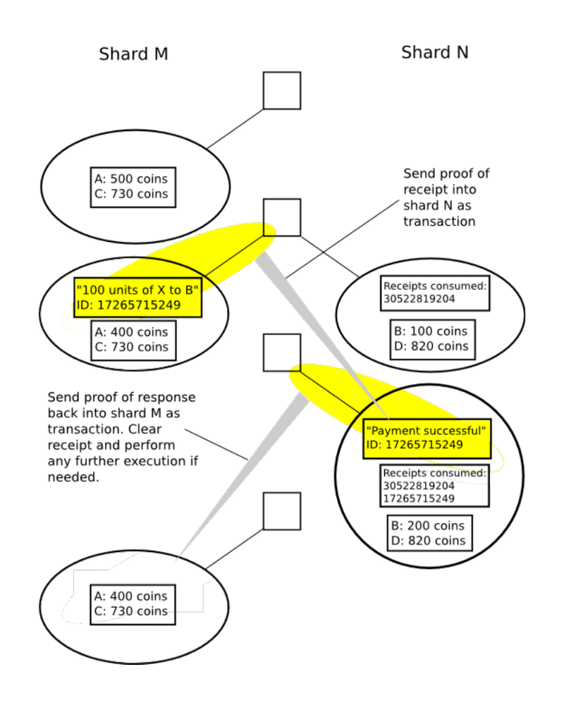
Image from Hackernoon via Blockgeets

Slide 36
Ethereum Clients: Geth
Geth (“go ether”) is the original and most popular Ethereum client; a command line interface for running an Ethereum node.
It is written in Go, but does not require users to have knowledge of the Go language.
Geth can be used for a lot of things; there are many options to the command
Among the most common are the commands to create and manage Ethereum wallets (accounts), to create contracts, and to mine Ether.

Slide 37
Solidity
Solidity is a language to define Ethereum smart contracts.
An Ethereum contract is like a class.
A contract may have any number of functions.
A function is like a method, with defined accessibility, parameters and return value.
A contract can have a constructor which is run by the owner, and that owner is typically saved. Functions may be programmed to only be accessible to that owner.
A contract can also have state variables, including arrays such as those mapping all users to values. These can be used for purposes such as storing account values.

